Slide 1

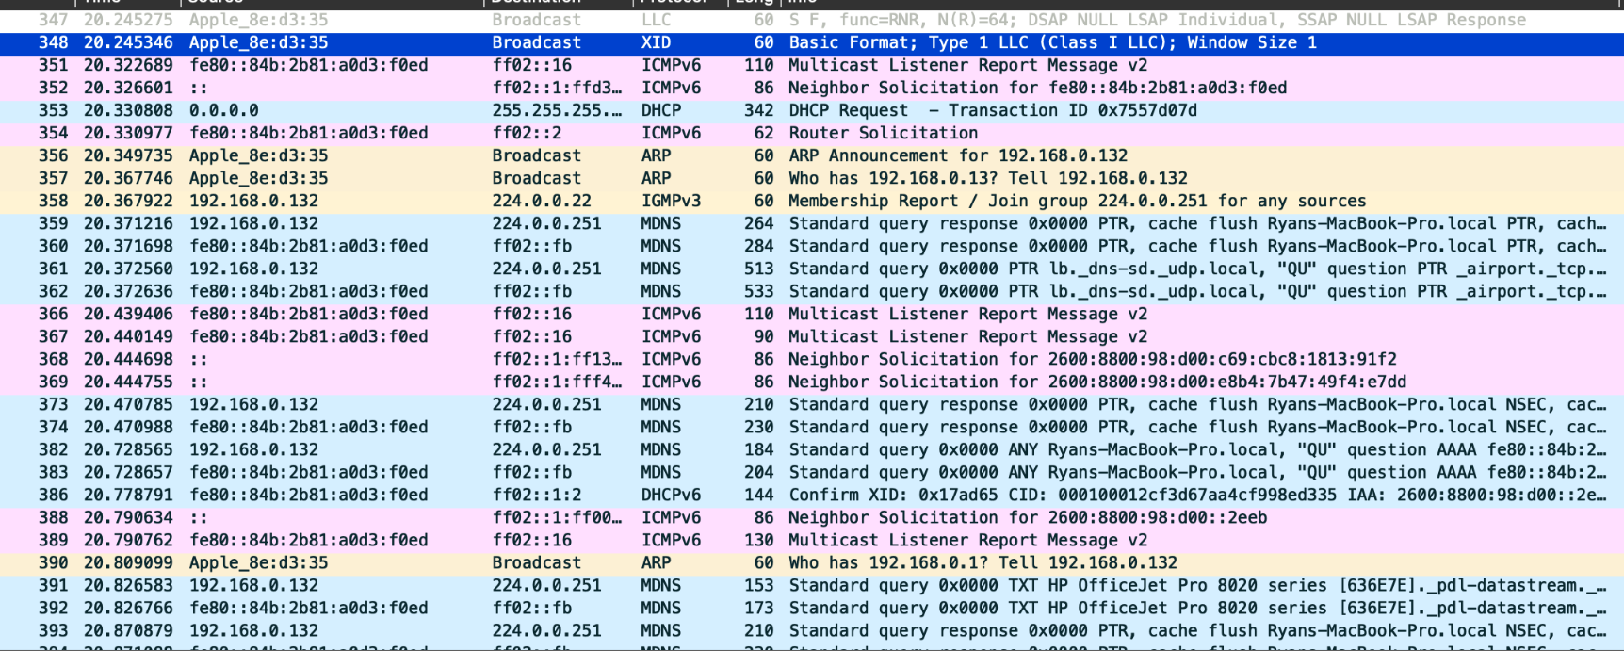
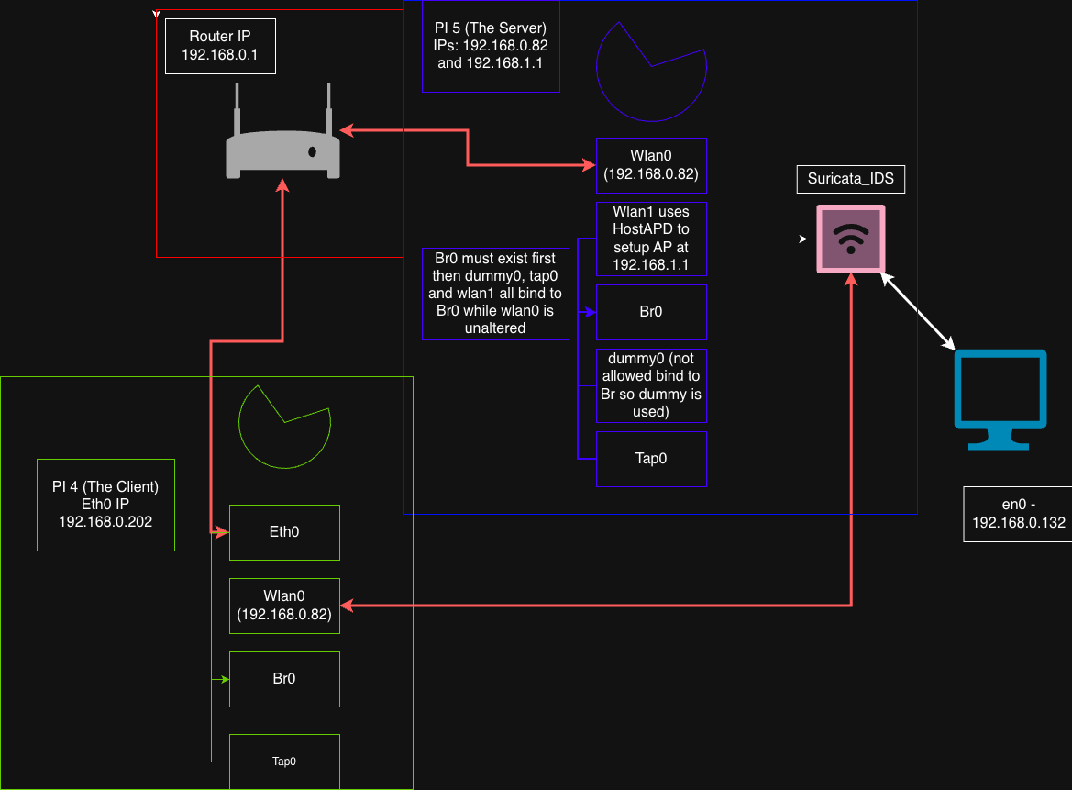
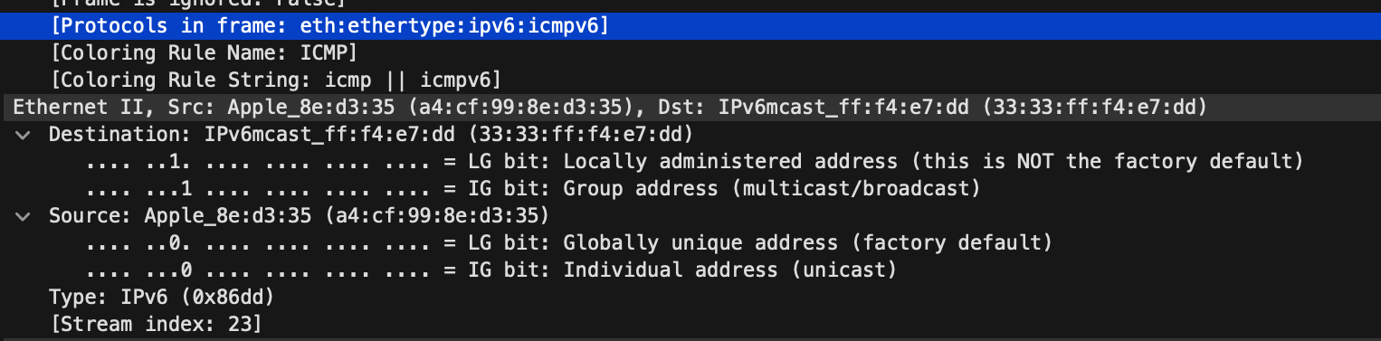
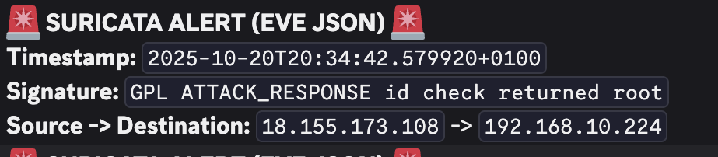
Ryan Becker
Faculty Advisor: Dr. Feng Wang
School of Mathematical and Natural Sciences
Raspberry Pi TAP to Monitor Layer 2 Traffic in Home Network
Introduction
Network Traffic and the User’s Schedule
Throughout this project, creation of a Network IDS was an ultimate goal. After performing a few attacks like ARP poisoning and Man in the Middle attacks, monitoring what occurred during these attacks was then an essential task. Initial creation of a IDS that used rules to alert in Discord was done, but a key observation of the traffic being captured was not capturing the data link layer (Layer 2). The traffic and alerts were only occurring on the Network Layer and Transport Layer so ARP packets are missed leading to missed ARP Poisoning..
With this limitation, the new core goal was to overcome these limitations to see data link layer traffic. By creating a transparent data link layer bridge between my router and a “Test_AP” using a Raspberry PI. When a client connects to the secondary AP the PI running the data link layer bridge, ultimately leading to capturing data link layer packets.
PI Network Tap Topology
Layer 2 Traffic Analysis
Figure 3: Successfully showing Datalink Layer Packets like ARP, LLC, XID and ICMPV6 packets
Figure 4: Showcasing Macbook is now a bridge connected to router with ethernet and connected to AP
What is an IDS?
These two images capture a MacBook (...d3:35) engaging in its initial network discovery and configuration process. The detailed packet view in the first image shows the MacBook sending an ICMPv6 message from the unspecified IPv6 source address (::) to an IPv6 multicast address (...fff4:e7dd), a pattern consistent with Neighbor Discovery Protocol (NDP) steps like a Neighbor Solicitation to begin acquiring an address. The packet list in the second image further illustrates the intense initial chatter of the MacBook, featuring a mix of ICMPv6 packets, DHCP for IPv4, and heavy use of Multicast DNS (MDNS), all essential for the device to locate services, resolve names, and fully establish its network presence.
An Intrusion Detection System (IDS) is a crucial component of network security, designed primarily to passively monitor network traffic or system logs to identify malicious activity, security breaches, or policy violations. It functions by continuously analyzing data against established benchmarks, which typically include predefined signatures of known attacks (signature-based detection) or recognizing deviations from normal operational behavior (anomaly-based detection). When suspicious activity is flagged, whether it's an attempted network scan, a malware command-and-control communication, or a user logging in during odd hours, the IDS generates an immediate alert for security staff to investigate and address the potential threat.
Figure 2: Network Topology Demonstrating How Interfaces Work Together to Create a Tunnel
Core Server Logic to Acheive TAP
Core Client Logic to Acheive TAP
Discord IDS Alerts
The Pi 5's main logical challenge is to create a secure, transparent entry point for client traffic and funnel it into the VPN tunnel. This is achieved by first establishing a Linux Bridge (br0) that acts as a virtual switch. Since the Wi-Fi driver typically prohibits manually adding the Access Point interface (wlan1) to a bridge, the HostAPD configuration is instructed to add it automatically (bridge=br0). To ensure the bridge is stable before HostAPD starts, a virtual tap0 interface (the OpenVPN server endpoint) and a dummy0 interface are created and bound to br0 first, serving as essential anchor ports. Once established, any client traffic entering the AP (wlan1) is passed transparently through the bridge and immediately duplicated to the tap0 interface, where it is encapsulated into the OpenVPN L2 tunnel for encrypted transit to the IDS client.
The Pi 4's core logical function is to receive the tunnel traffic and complete the transparent bridge to the router, making the traffic available for passive inspection. The primary logical step here is the creation of a second Linux Bridge (br0) on the client, which serves as the IDS tap point. The OpenVPN client is configured to exit the tunnel onto its virtual tap0 interface, which is immediately bound to br0 via the client startup script. Crucially, the physical Ethernet interface connected to the router (eth0) is also bound directly to the same br0 bridge. This configuration forces all incoming raw Ethernet frames from the tunnel (tap0) to pass through the br0 virtual switch before being forwarded out to the router (eth0), allowing the Suricata IDS to listen passively on the br0 interface and inspect every single Layer 2 frame without interrupting the network flow.
Figure 1: Showcasing Initial IDS Alerts occurring burt only capturing Netwrok and Transport Packets to alert from
The previous intrusion detection setup was a practical, automation-focused system designed to streamline security monitoring using Suricata as the core IDS sensor. This system was configured to process network flow information, primarily focusing on Layer 3 (IP addresses) and Layer 4 (TCP/UDP ports) data. When Suricata identified a signature match or anomaly, for example, unusual port scanning, known malware command-and-control traffic, or policy violations, a script would immediately parse the alert output. This script then used a webhook integration to dispatch a notification directly to a designated Discord channel. While this system provided efficient, near-real-time alerting for traffic traversing the routing layer and significantly improved our incident response time for network- and transport-layer attacks, it inherently lacked visibility into the Data Link Layer (Layer 2). This meant the IDS remained blind to low-level attacks such as ARP spoofing or MAC flooding that operate at the Ethernet framing level.
Conclusion and Future Work
References
The construction of this transparent layer 2 bridge successfully achieved the goal of universal network visibility, providing a crucial security upgrade over previous layer 3 and layer 4 monitoring methods. By forcing traffic across a bridged TAP tunnel, we established a robust, hardware-agnostic platform capable of performing deep packet inspection on all Ethernet frames, ensuring the IDS can detect sophisticated threats and anomalies that occur at the fundamental layers of the network stack.
In the future, there will be Suricata added onto the client pi to take over the Discord alerts to ultimately create an IDS that is functioning on all OSI layers.
https://arxiv.org/abs/2510.23313
https://www.cisco.com/c/en/us/support/docs/lan-switching/spanning-tree-protocol/10543-chapter20.html
https://www.andovercg.com/datasheets/sonicwall-Bridge_Mode_and_Transparent_Mode_Deployment_Guide.pdf
Notes:
Remove meross light from schedule
start from the time stamp and go forward
header on the wireshark
group ids in the house layout form
Each photo has a figure #
Number of lights in each room
Hw the rooms work

